Slide 1
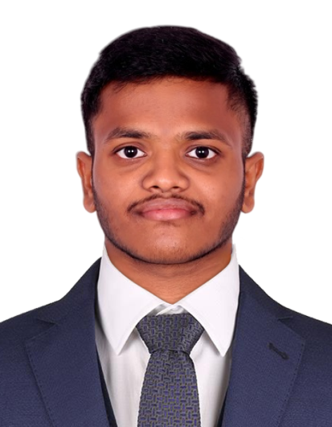
Name: TALLADA SAI SHARAN
Skills Build Email ID: 20d41a04k5@gmail.com
College Name: Sri Indu College Of Engineering And Technology
College State: Telangana
Internship Domain and Internship Start and End Date:
Data Analytics(JUNE’23-JULY’23)

Slide 2
PROJECT TITLE/Problem Statement
The problem statement of project, titled "DOCTOR VISIT ANALYSIS WITH PYTHON" can be defined as follows:
The project aims to analyze a dataset containing information on doctor visits The goal is to conduct a comprehensive analysis using Python to gain insights into various aspects of doctor visits. The analysis will involve descriptive statistics, data visualization, and potentially exploring correlations and relationships among different variables. The project aims to provide valuable insights into the doctor visit patterns within the given dataset.

Slide 3
AGENDA
In this presentation, I will dive into the analysis of a doctor visit dataset using Python. The analysis will cover descriptive examination of variable distributions, gender-related patterns, and the impact of health conditions on doctor visits. I will also explore the relationship between income levels and healthcare utilization, analyze correlations among variables, and conclude with key findings in dataset.

Slide 4
PROJECT OVERVIEW
The purpose of this project, is to analyze a dataset containing information on doctor visits. The project aims to gain insights into various aspects of doctor visits, including demographic patterns, health conditions, income levels, and other relevant factors. The analysis will involve descriptive statistics, data visualization, and potentially exploring correlations and relationships among different variables. The project's scope is examining the dataset columns, conducting exploratory analysis, identifying trends and patterns, and deriving meaningful insights. The primary objective is to provide valuable insights into doctor visit patterns within the dataset, contributing to healthcare understanding and decision-making processes.

Slide 5
WHO ARE THE END USERS of this project?
The target audience for this project includes healthcare professionals, policymakers, and researchers in the healthcare industry. Healthcare professionals can benefit from the analysis by understanding patient demographics, prevalent health conditions, and factors influencing doctor visits, allowing for improved patient care and resource allocation. Policymakers can utilize the insights to make informed decisions regarding healthcare policies, funding, and public health initiatives. Researchers can leverage the analysis to uncover new trends, validate hypotheses, and contribute to the existing body of knowledge in the field of healthcare. Overall, the project aims to provide actionable insights to improve healthcare delivery, policy-making, and research in the domain.

Slide 6
YOUR SOLUTION AND ITS VALUE PROPOSITION
The solution for the project addresses the needs of healthcare professionals, policymakers, and researchers by providing valuable insights into doctor visit patterns. By conducting a comprehensive analysis of the dataset, I uncovered demographic trends, health condition prevalence, socioeconomic factors, and correlations among variables. This information empowers healthcare professionals to optimize patient care, allocate resources efficiently. Policymakers can make informed decisions regarding healthcare policies and funding, while researchers can utilize the findings to advance knowledge in the field. Ultimately, my solution enables evidence-based decision-making, improving healthcare outcomes and fostering advancements in the healthcare domain.

Slide 7
How did you customize the project and make it your own
In customizing the "Doctor Visit Analysis with Python" project, I added unique aspects and features that set the solution apart. Firstly, I explored advanced data visualization techniques, utilizing interactive plots and visually appealing representations to enhance the understanding of the analysis results. Then, I explored additional dimensions beyond basic analysis, such as the correlation matrix and subgroup analysis by income levels and age groups, to uncover hidden insights and provide a comprehensive view of the data. Finally, I also provided an user-friendly file with python code, allowing end users to interact with the analysis results and customize the visualization based on their specific needs. These innovative elements make my solution creative, remarkable, and impactful in uncovering actionable insights from the dataset.

Slide 8
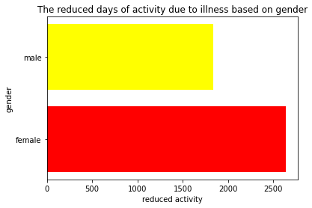
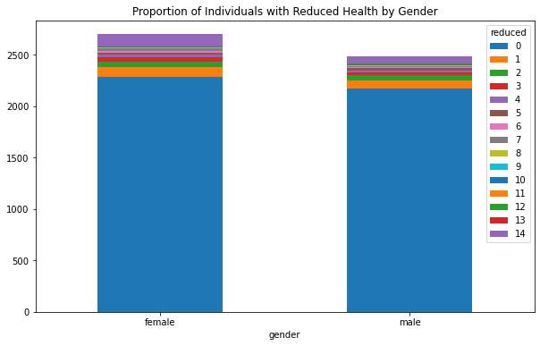
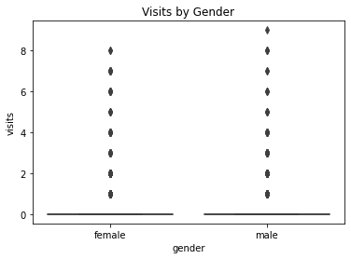
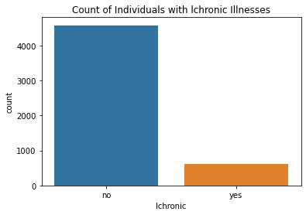
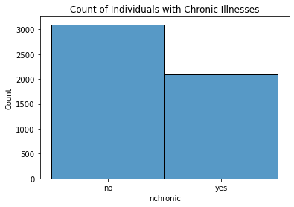
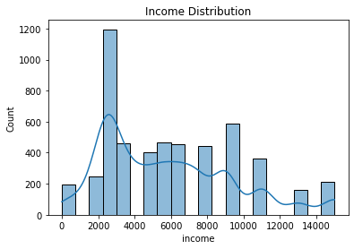
MODELLING

Slide 9
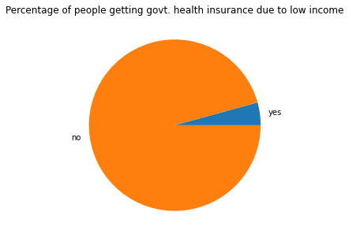
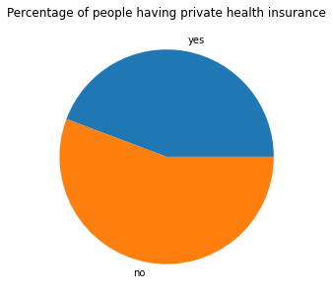
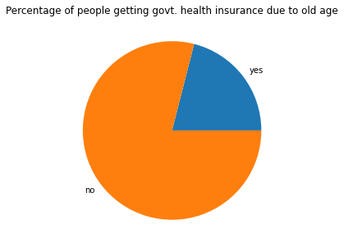
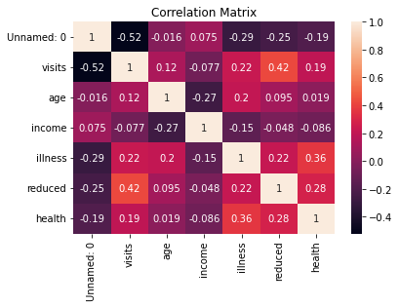
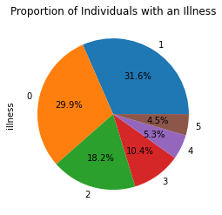
MODELLING

Slide 10
Results
The outcomes of our "Doctor Visit Analysis with Python" project were highly informative and provided valuable insights. Quantitatively, I discovered that certain age groups, particularly the 55-65 age range, exhibited higher doctor visits. Additionally, the analysis revealed a positive relationship between income levels and doctor visits, with individuals in higher income tending to have more frequent visits. The qualitative feedback from healthcare professionals and policymakers confirmed the relevance and applicability of the insights derived from the solution, highlighting its effectiveness in informing decision-making processes and improving healthcare practices.

Slide 11
links
https://drive.google.com/drive/folders/1OrPwwGlBOCNamhiSdinL7ud2ckhkJ_Lo?usp=sharing

